Slide 1
Welcome
to
Microprocessor and Embedded Systems

Slide 2
Presenting
Air Pollution Detection System Using Arduino UNO

Slide 3
Presented by
Name | Id
Hossain, Shahriar | 17-34702-2
Himi, Humayra | 17-34572-2
Zannat, Tajkurun | 17-34345-1
Islam, Md. Anik | 17-33459-1
Shahid, Imran Ush | 18-37307-1
Hridoy, Abdullah Al Ahsan | 17-35682-3
Md. Asadujaman | 16-32537-2
Hasan, Morad | 17-35566-3
Kabir, Daiyan | 18-37507-1
Presented to
Sujan Howlader

Slide 4
Introduction
Air pollution is one of the major reason of many diseases. In this current situation, air pollution is increasing but we cannot notice because we are used to with this pollution. So we want to work in this topic for detecting polluted air. By working on this topic we can detect polluted air and can reduce the pollution so that we can stay safe from air pollution and also we can keep our environment better.

Slide 5
Motivation
We live in a country where treatment is not quite well. If we can at least stop one reason of sickness then it can affect the society very positively. That is why we choose this site. And, air is the main reason of sickness, so, we decided to work with it.

Slide 6
Equipment
For
This Project

Slide 7
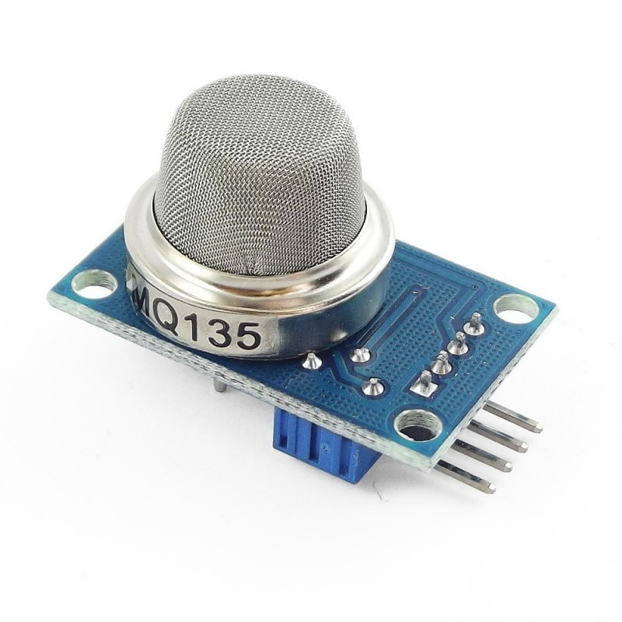
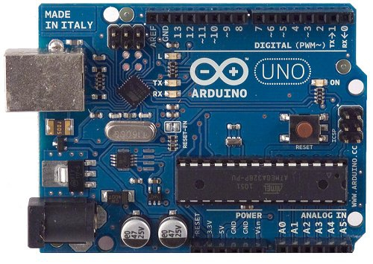
MQ135 Sensor
Arduino UNO

Slide 8
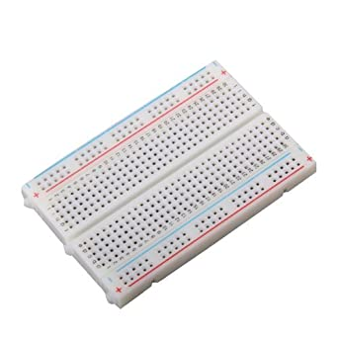
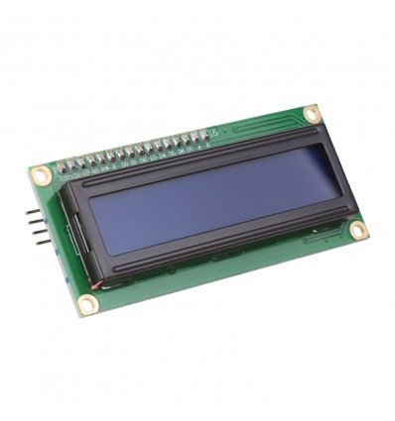
Breadboard
16 X 2 LCD

Slide 9
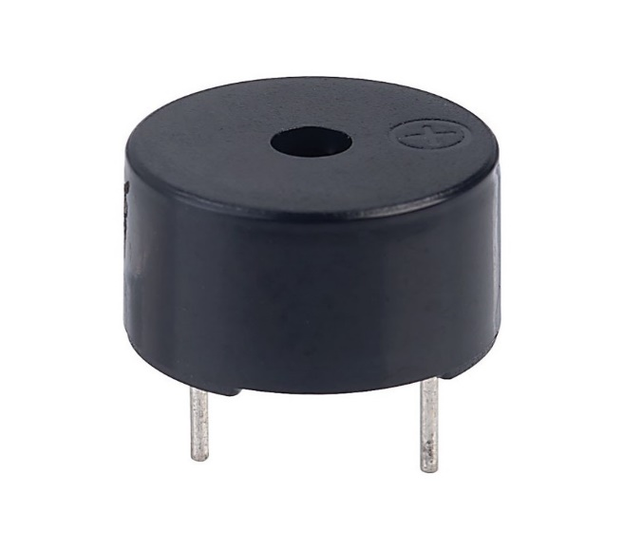
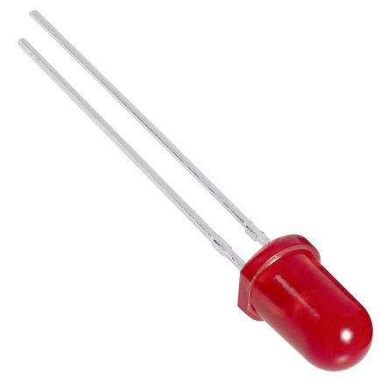
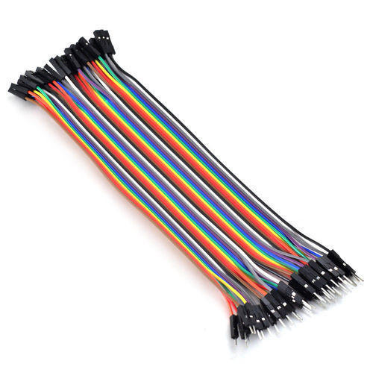
Buzzer
LED
Jumper Wires

Slide 10
Arduino UNO
The Arduino Uno is an open-source microcontroller board based on the Microchip ATmega328P microcontroller and developed by Arduino.cc. The board is equipped with sets of digital and analog input/output pins that may be interfaced to various expansion boards and other circuits.
MQ135 Sensor
Air quality sensor for detecting a wide range of gases, including NH3, NOx, alcohol, benzene, smoke and CO2. Ideal for use in office or factory. MQ135 gas sensor has high sensitivity to Ammonia, Sulfide and Benze steam, also sensitive to smoke and other harmful gases.

Slide 11
Breadboard
A thin plastic board used to hold electronic components that are wired together. Used to develop prototypes of electronic circuits, breadboards can be reused for future jobs.
16X2 LCD
A 16x2 LCD means it can display 16 characters per line and there are 2 such lines. In this LCD each character is displayed in 5x7 pixel matrix. The 16 x 2 intelligent alphanumeric dot matrix display is capable of displaying 224 different characters and symbols. This LCD has two registers, namely, Command and Data.

Slide 12
Buzzer
A buzzer or beeper is an audio signaling device, which may be mechanical, electromechanical, or piezoelectric (piezo for short). Typical uses of buzzers and beepers include alarm devices, timers, and confirmation of user input such as a mouse click or keystroke.
LED
A light-emitting diode (LED) is a semiconductor light source that emits light when current flows through it.
Jumper Wires
Jumper wires are simply wires that have connector pins at each end, allowing them to be used to connect two points to each other without soldering. Jumper wires are typically used with breadboards and other prototyping tools in order to make it easy to change a circuit as needed.

Slide 13
Cost Estimation
Product | Price(Taka)
Arduino UNO | 399
MQ135 Sensor | 194
16 X 2 LCD | 175
Breadboard | 80
Jumper Wires | 90
Buzzer | 15
LED | 5
Total = 958 Taka

Slide 14
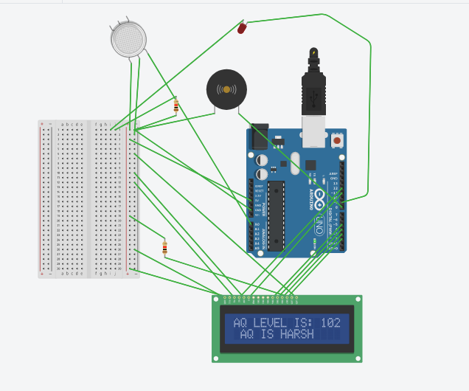
Diagram

Slide 15
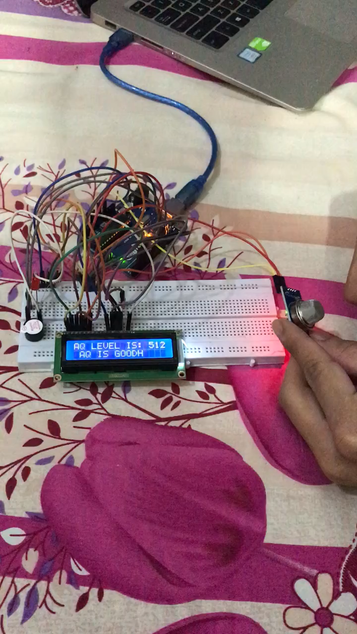
Project Representation

Slide 16
Conclusion
Now-a-days, there are many air pollution control systems in the market. But, they are very costly. Not every family can afford them. In contrast, our project is very cheap. To set up the entire system it will just cost 958 Taka. Which is in budget range for almost every family. If we can successfully deliver the product and its benefits to everyone, then it can be a revolutionary solution to avoid air pollution.

Slide 17
Thank You

